Slide 1
Lecture 13 Hydrogen storage

Slide 2
PREVENTIVE MEASURES TO AVOID H2 ACCIDENIS
Leak prevention: Leakage of H2 from containers and
pipelines is expected to be 1.3—2.8 times higher than gaseous methane leakage and
approximately 4 times than that of air under the same conditions:
"airproof is not hydrogen-proof.“
Hydrogen generation, storage systems should be installed at remote area
(distant from human habitation), kept away from fire hazards, & electrical sparking
Trained personnel should operate the H2 facility
In case of hydrogen fire:
People/animal should immediately be evacuated from the place
to a safer distance
It should be allowed to burn the complete hydrogen

Slide 3
SAFETY GUIDELINES ON HYDROGEN SYSTEMS
Approval of government bodies (India: PESO) after installation of H2 systems
• Each building block will be properly distanced
• Standard piping/fittings/storage equipment
• Regular inspection of hydrogen relief valves
• Proper calibration of H2 sensor and alarms H2 system should be installed outside in open air
• Proper ventilation (forced + natural) in case of inside installation
• Training and certification on hydrogen safety (US-
DOE)
8-16 m

Slide 4
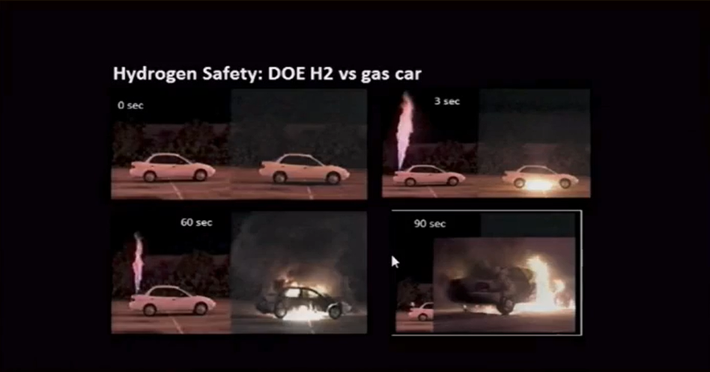
BURNING OF HYDROGEN VS GAS CAR
Source: YouTube, Hydrogen vs. Gasoline Leak and Ignition Test- which is safer?

Slide 5
HYDROGEN STORAGE

Slide 6
HYDROGEN STORAGE METHODS
• Hydrogen storage in its purest form:
Gaseous storage of hydrogen
Liquid storage of hydrogen
• Hydrogen storage in materials
(condensed)
Key factors for hydrogen storage methods
1.Volumetric density (kg/L)
2.Gravimetric density
3.Kinetics (H2 uptake and release rate)
4.Cost
5.Operational temperature
6.Hydrogen release pressure

Slide 7
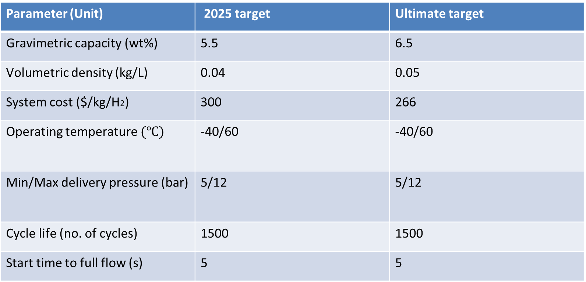
ON-BOARD HYDROGEN STORAGE TARGETS: US DOE
Parameter (Unit) | 2025 target | Ultimate target
Gravimetric capacity (wt%) | 5.5 | 6.5
Volumetric density (kg/L) | 0.04 | 0.05
System cost ($/kg/H2) | 300 | 266
Operating temperature $(℃)$ | -40/60 | -40/60
Min/Max delivery pressure (bar) | 5/12 | 5/12
Cycle life (no. of cycles) | 1500 | 1500
Start time to full flow (s) | 5 | 5

Slide 8
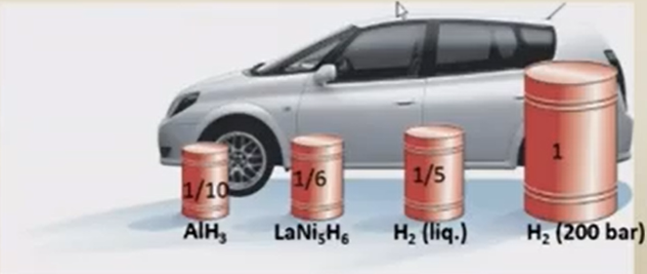
HYDROGEN STORAGE FOR TRANSPORT APPLICATION: EFFECT OF VARIOUS IODS ON SIZE OF Tl IE TANK
Volume of 4 kg of H2 (200 mile driving range)

Slide 9
GASEOUS HYDROGEN STORAGE IN TANKS
Tank type | Pressure | Material | Wt%
Type – I | 200 Bar | All metal (steel) | 1.7
Type – II | 200 Bar | Mostly steel Glass – fiber Composite Overwrap in the hoop direction | 2.1
Type – III | 350 Bar | Mental liner with full carbon composite overwrap | 4.2
Type – IV | 700 bar | All-composite Construction + liner with carbon fiber | 5.7
Not for h2
compressor
H2 generation
plant
Butter Tank
Type - II
High pressure tanks
Type – II, III & IV

Slide 10
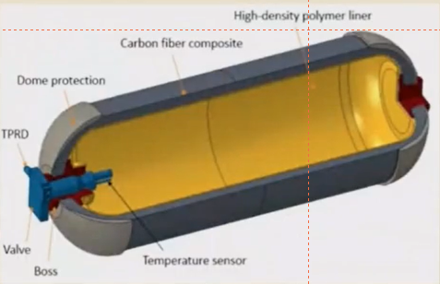
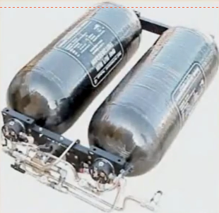
TYPE – IV TANK
Cross- section of type- IV cylinder
A set of type – IV cylinder used in h2 FC vehicles

Slide 11
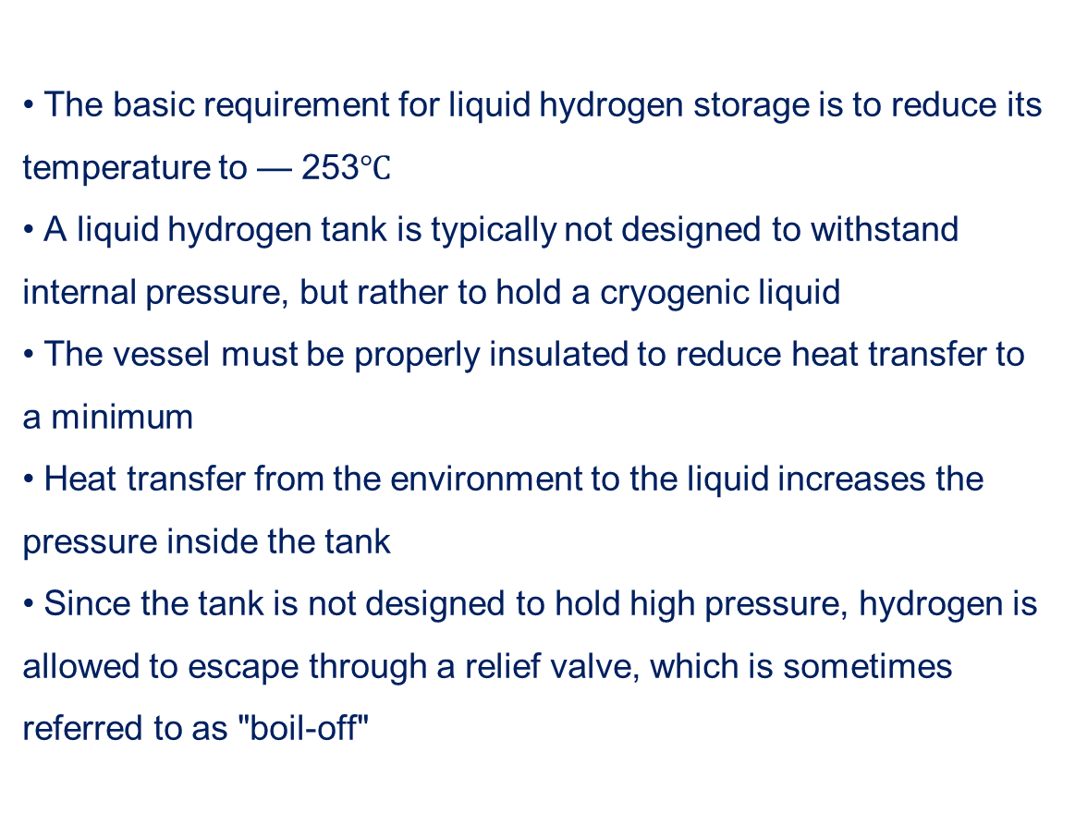
LIQUID STORAGE OF HYDROGEN
• The basic requirement for liquid hydrogen storage is to reduce its
temperature to — 253$℃$
• A liquid hydrogen tank is typically not designed to withstand
internal pressure, but rather to hold a cryogenic liquid
• The vessel must be properly insulated to reduce heat transfer to
a minimum
• Heat transfer from the environment to the liquid increases the
pressure inside the tank
• Since the tank is not designed to hold high pressure, hydrogen is
allowed to escape through a relief valve, which is sometimes
referred to as "boil-off"

Slide 12
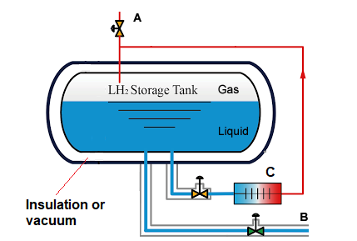
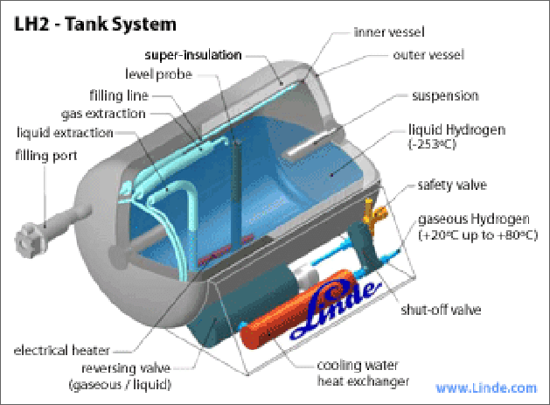
LIQUID HYDROGEN TANK
A LH2 tank to supply hydrogen for marine
application
Issue of LH2
Energy intensive process
- Hydrogen loss

Slide 13
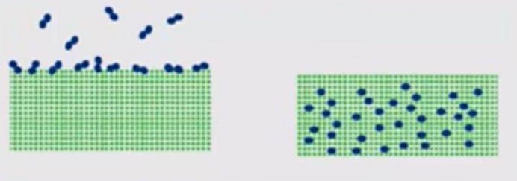
HYDROGEN STORAGE IN CONDENSED STATES: TWO TYPES
Physisorption
Surface storage
Example: absorbents
(carbon, MOF ect.)
Chemisorption
Storage into matter
Example: metal hydrides, chemicals

Slide 14
H2 STORAGE IN CONDENSED STATES
Hydrogen storage materials
Adsorbent
Metal hydrides
Chemicals
MOF
Carbon
zeolites
Liquid organic hydrogen carrier (LOHC)
Other
NH3
Methanol
Formic acid
Element metal hydrides intermetallic hydrides
Complex hydrides
AIH3,MgH2
laNishx, TiFeHx
NaAIH4,LiNH2, LiNH4

Slide 15
Thank You

